Slide 1
The Human Endocrine System
Chemical Signals in Animals

Slide 2
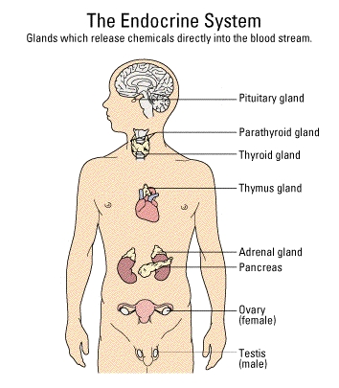
I. The Endocrine System
The endocrine system is a collection of glands that produce and release chemical messages we call hormones.
a) Glands are groupings of specialized cells that produce and release hormones into the blood.
b) The endocrine system (and nervous system) maintains homeostasis.
c) Homeostasis is the part of regulation in which the internal conditions are kept constant.

Slide 3
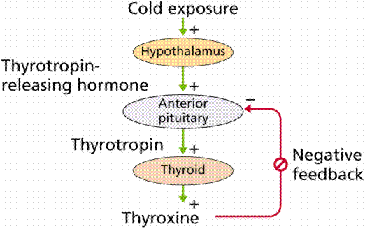
d) Endocrine Systems and Feedback Cycles
The endocrine system uses cycles and negative feedback to regulate the life functions.
1. Negative feedback regulates the secretion (production and release) of almost every hormone.
As the concentration of one hormone increases, the concentration of another decreases.
Negative feedback in the thyroxine release reflex. Image from Purves et al., Life: The Science of Biology, 4th Edition, by Sinauer Associates (www.sinauer.com) and WH Freeman (www.whfreeman.com), used with permission.

Slide 4
e) Mechanisms of Hormone Action
The endocrine system acts by releasing hormones that cause actions in specific organs.
Receptors on specific organs bind only to one type of hormone.
Ex: Follicle Stimulating Hormone (FSH) will only cause a response in the female ovarian follicle which contains the egg (ova).
More than fifty human hormones have been identified; all act by binding to specific receptor molecules. The binding hormone causes the response to the hormone.

Slide 5
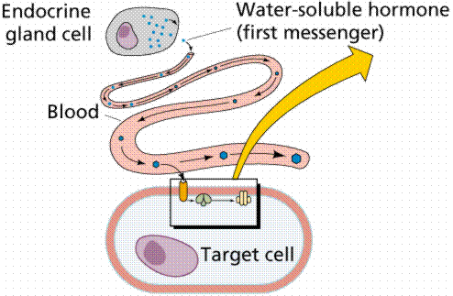
There are two mechanisms of hormone action on all target cells.
1. Water Soluble Hormones do not enter the cell but bind to plasma membrane receptors, producing a chemical signal (second messenger) inside the specific cell to create the specific response.
An example of a second messenger includes cyclic AMP.

Slide 6
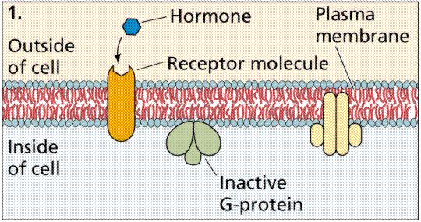

Slide 7
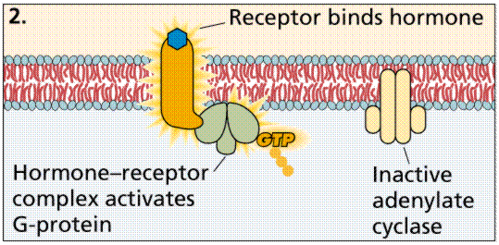

Slide 8
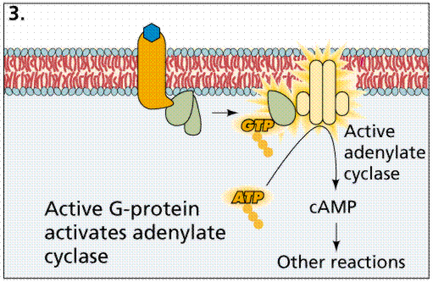
The action of nonsteroid hormones. Images from Purves et al., Life: The Science of Biology, 4th Edition, by Sinauer Associates (www.sinauer.com) and WH Freeman (www.whfreeman.com), used with permission.

Slide 9
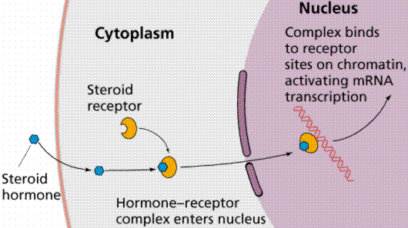
2. Lipid Soluble Hormones pass through the plasma membrane and act in a two step process.
Once inside the cell, Lipid Soluble Hormones bind to the receptors on the nuclear membrane.
This activates specific genes, increasing production of proteins.

Slide 10
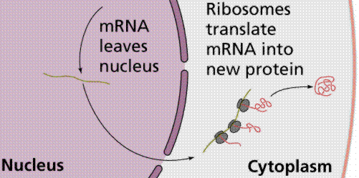
The action of steroid hormones. Images from Purves et al., Life: The Science of Biology, 4th Edition, by Sinauer Associates (www.sinauer.com) and WH Freeman (www.whfreeman.com), used with permission.

Slide 11
e) Hormone Types and Functions
The Pituitary Gland :
Located in the Brain
Called the “Master Gland”.
Hormones of the Pituitary Gland
ADH (Antidiuretic Hormone) used to retain water in the kidneys.
Oxytocin contraction of the muscles of the uterus (childbirth) and causes the mammary glands to secrete milk.
TSH (Thyroid Stimulating Hormone) stimulates thyroid to produce thyroxin.
FSH (Follicle Stimulating Hormone): causes the ovarian follicle of women to develop.
LH (Luteininzing Hormone): releases the egg from the ovarian follicle of women.
Prolactin (PRL) stimulates milk production
Growth Hormone (GH) causes growth; secreted over a long time; too much leads to giantism, and too little leads to dwarfism.

Slide 12
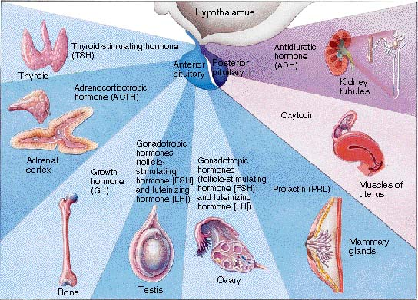

Slide 13
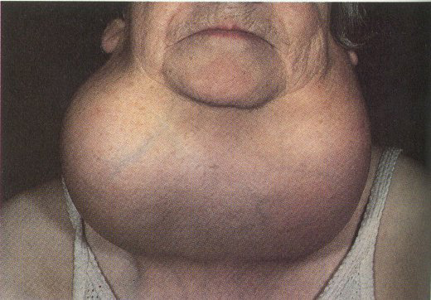
2. Thyroid Gland produces thyroxin, which control the rate of metabolism.
TSH (thyroid stimulating hormone) which is released by the pituitary causes the thyroid to produce thyroxin.
Thyroxin contains iodine. A goiter is result of lack of iodine and the result is an enlarged thyroid gland.
  Hyperthyroidism: an over-secretion of thyroxine which causes eye bulging, nervousness, sweating.
  If not treated can cause a form of mental retardation.

Slide 14
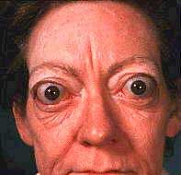

Slide 15
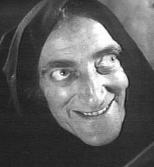

Slide 16


Slide 17
3. Parathyroid Glands
PTH (Parathormone) influences the calcium level in the blood.
If low blood calcium PTH preserves calcium by degrading bone.
High levels of calcium in the blood causes the thyroid to produce calcitonin, which puts calcium in bones and excretes it out the kidney and bladder.

Slide 18
4. Pancreas : Endocrine and Exocrine Gland
Makes insulin and glucagon.
    Insulin is a protein which takes glucose to the cells.
    High blood sugar
      Pancreas secretes insulin and causes blood glucose to be absorbed into the cells.
    Low blood sugar
      Pancreas secretes glucagon and causes liver to break down glycogen and produce glucose.

Slide 19
5. Adrenal Glands : Located on the top of the kidneys.
  Epinephrine (adrenaline) - (fight or flight responses).
  Adrenaline causes:
  an increase in heart and breathing rates
  increased blood flow to the muscles and decreased blood flow to the digestive system.
  dilation of the pupils.
the conversion of the polysaccharide glycogen to the energy rich monosaccharide glucose in the liver.

Slide 20
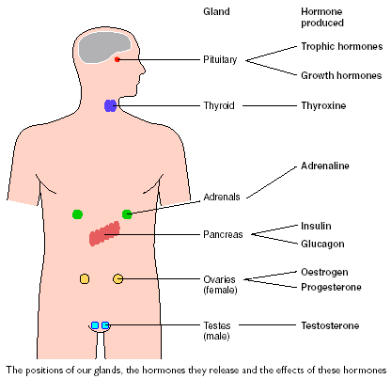

Slide 21
6. Testes :
The pituitary produces FSH (follicle stimulating hormone) and LH (Luteinizing Hormone).
LH stimulates cells in the testes to secrete testosterone, which has a role in sperm production and developing male secondary sex characteristics.
FSH (Follicle Stimulating Hormone) acts on cells to help in sperm maturation.
Negative feedback controls the levels of these hormones.

Slide 22
7. Ovaries
Ovarian Cycles : The ovarian cycle lasts usually 28 days.
Follicular phase (maturing follicles): The oocyte matures within a follicle. The release of FSH by the anterior pituitary stimulates the oocyte maturation.
Ovulation : The oocyte is released from the ovary and swept into the Fallopian Tubes aka oviducts (site of fertilization). A surge in LH from the anterior pituitary causes the ovarian follicle to burst.
Luteal phase (ruptured ovarian follicle): The corpus luteum synthesizes hormones (estrogen and progesterone) that causes the thickening of the uterine lining for pregnancy.
Menstrual Phase: The endometrium will break down if fertilation does not occur. This coincides with a decrease in the levels of estrogen released by the corpus luteum.

